Slide 1

HEALTHCARE MANAGEMENT
Streamlining hospital efficiencies through accurate prediction of patient length-of-stay
Dataset: AV : Healthcare Analytics II
Notes:
https://www.kaggle.com/nehaprabhavalkar/av-healthcare-analytics-ii

Slide 2





MEET THE TEAM
Vivek Dave
Lucas Freire
Hemant Kini
Siva Kodali
Greg Neal

Slide 3







Healthcare Management
Patient length of stay is a critical parameter to observe and predict in order to improve the efficiency for healthcare management in a hospital. Being able to accurately predict this parameter will assist hospitals in identifying patients with a higher length of stay (LOS) risk at time of admission. This model will assist with room and bed allocation planning logistics which will lead to higher efficiency and profits for the hospital.
Prediction
Judgment
Action
Outcome
Predict how long a patient will stay in the hospital.
Patients staying longer means an overallocation of beds, which will result in overcrowding and upset patients.
If patient is released before their predicted time period, the hospital will have empty beds, which will result in lost revenue
Implement a supervised classification model to predict the stay of an individual (given in a range of days).
Measuring the performance for model based on accuracy metrics (correctly predicting length of stay). We are aiming for better than baseline accuracy of 27%
Training
Input
Feedback
Used feature engineering to extract attributes from data and create better features
The hyperparameters surrounding the decision tree like criterion (gini coefficient and entropy) and the tree depths were tuned to identify the best performing model which yields around 40% of accuracy.
Accuracy was increased by finding the feature importance of each, and dropping/disregarding least important features.
Additional features such as gender and # of patients turned away due to being at capacity would have been helpful to determine efficiency of hospital operations.
Used historical stay times matched with historical Hospital Code, Hospital Type, Available Extra Rooms, Department, Ward Type, Bed Grade, Admission Type, Illness Severity, Number of Visitors with Patient, Age, and Admission Deposit
How will this AI impact the overall workflow?
Using the AI to predict length of stay will assist hospital decision-makers with properly allocating beds to the areas of the hospital that need them with the goal being to minimize the number of open beds without overallocation. The impact of the AI work to the hospital will be the knowledge for them to be able to predict the number of patients in each departments at any given time so that the proper number of beds and staff can be deployed.
© Agrawal, Gans, Goldfarb 2019

Slide 4
EDA & Preprocessing: Feature Understanding
Categorical Features:
Age
Bed Grade
City_Code_Hospital
City_Code_Patient
Department
Hospital_code
Hospital_region_code
Hospital_type_code
patientid
Severity of Illness
Stay
Type of Admission
Ward_Facility_Code
Ward_Type
Numerical Features:
Admission_Deposit
Available Extra Rooms in Hospital
caseid
Visitors with Patient
Notes:
Started by encoding all features to check for correlation.
Groups

Slide 5
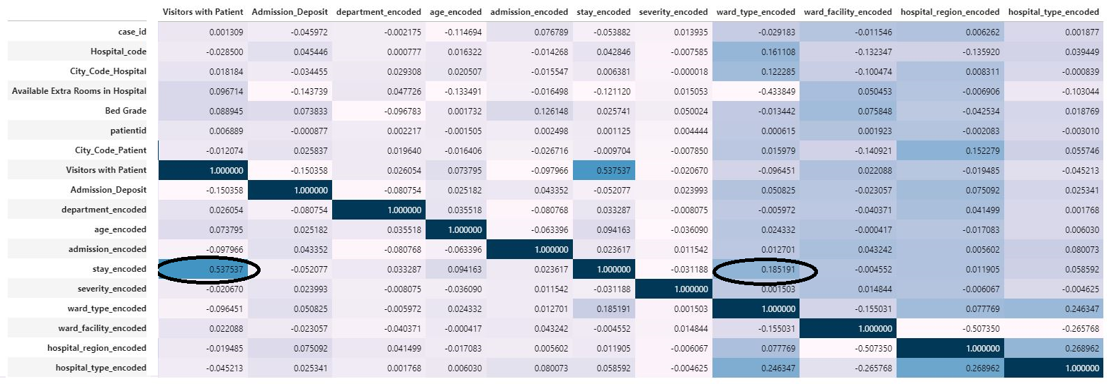
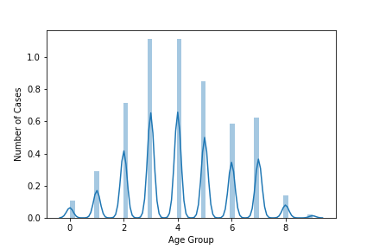
EDA & Preprocessing: Feature Analysis
Much of the data does not seem to be correlated with the patient's length of stay and is generally evenly distributed across all features.
Age distribution of the patients were mostly within the 31-40 and 41-50 ranges.
Length of stay was most highly correlated with the number of visitors a patient had.
Notes:
Started by encoding all features to check for correlation.
Most were not very correlated, with only “Visitors of Patient” being the most pronounced.
Thing that stood out “The severity of an individual’s admission to the hospital does not appear to correlate with their length of stay.”
Gynecology was the most frequented department.
Go into specifics of what the axes represent.

Slide 6
EDA & Preprocessing
Numerical features were separated, and categorical features were OneHotEncoded.
Null values were addressed by using SimpleImputer to use the most frequent value for the feature.
City_Code_Patient – 3654 missing values
Bed Grade – 94 missing values
New features were engineered, but ultimately brought down our model’s accuracies.
Attempted Features:
“Number of Patient Visits”
“Proximity Ranking for the Hospital”
Notes:
Most frequently used as the average bed grade could vary and the most commonly available amount would help provide a more typical scenario of when a patient enters the hospital.
City Code Patient is tied to where the patient originated from, where the most frequently visited hospital would be the obvious choice.

Slide 7
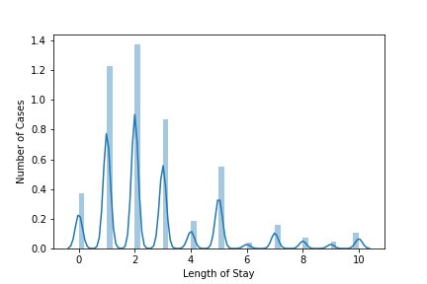
Model Training, Tuning, and Selection (Performance)
The hyperparameters surrounding the decision tree like criterion (gini coefficient and entropy) and the tree depths were tuned to identify the best performing model which yields around 40% of accuracy.
Max Depth: 10
Gini coefficient
Tuning the hyperparameters surrounding the logistic regression regarding the penalty type, solvers and max iterations didn’t yield better results than the decision tree or random forest outcomes.
Baseline score – the highest percentage of total value counts for the length of stay of each hospital visit.
Accuracy score was found using cross validation within the dataset.
Baseline accuracy: 27.48% for length of stay of 11-20 days.
Decision tree accuracy: 40.82%
Random forest accuracy: 37.43%
Logistic regression accuracy: 27%
Notes:
As we are not as concerned with a false positive or false negative result that could cause a serious medical issue, we used accuracy to measure our model’s performance.
Go into specifics of what the axis represent.

Slide 8
Limitations of the Dataset
Specific age vs. the current age ranges
Gender
Specific stay dates
Acute vs chronic illnesses
Reason for hospital discharge
Better defined feature dictionary
Notes:
Things that would have made our dataset better and more specific and improved model performance.

Slide 9
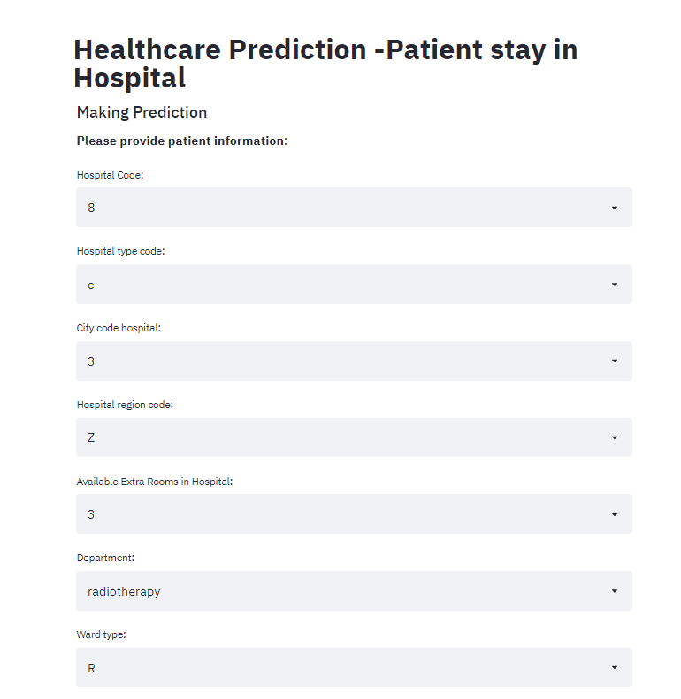
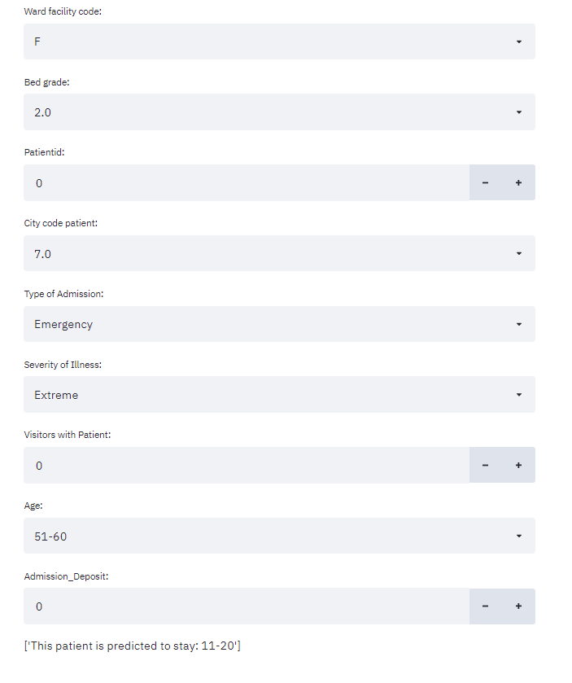
ML Web App

